Slide 1
Swin Transformer V2 Scaling Up Capacity and Resolution
Microsoft Research Asia arXiv, 11/2021

Slide 2
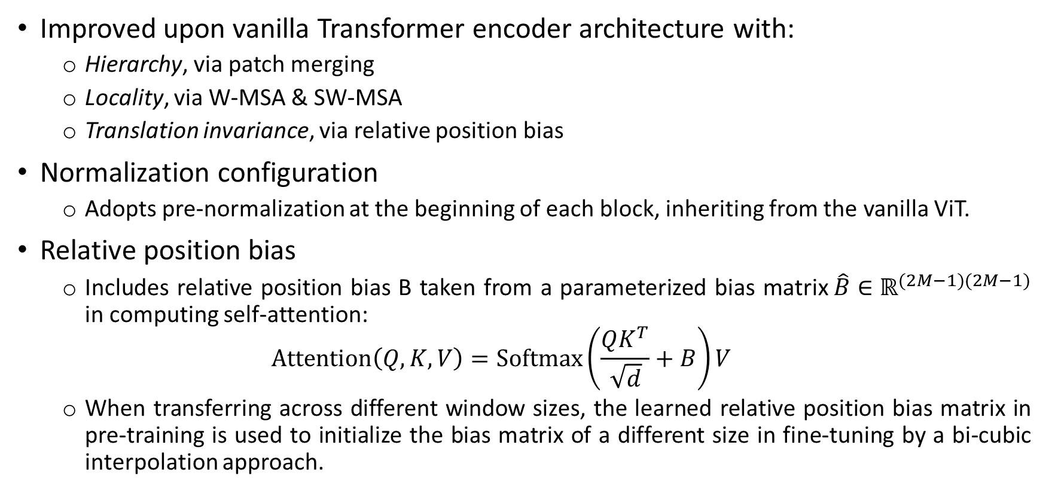
Swin: Brief Review
Improved upon vanilla Transformer encoder architecture with:
Hierarchy, via patch merging
Locality, via W-MSA & SW-MSA
Translation invariance, via relative position bias
Normalization configuration
Adopts pre-normalization at the beginning of each block, inheriting from the vanilla ViT.
Relative position bias
Includes relative position bias B taken from a parameterized bias matrix$\hat{B}∈ℝ^{(2M−1)(2M−1)}$ in computing self-attention:
$$Attention\left(Q,K,V\right)=Softmax\left(\frac{QK^{T}}{\sqrt{d}}+B\right)V$$
When transferring across different window sizes, the learned relative position bias matrix in pre-training is used to initialize the bias matrix of a different size in fine-tuning by a bi-cubic interpolation approach.
Notes:
where B $∈$ R^{M2xM2} is the relative position bias term to each head
Q,K,V $∈$ R^{M2xd} are the query, key and value matrices
d is the query/key dimension, and M² is the number of patches in a window.

Slide 3
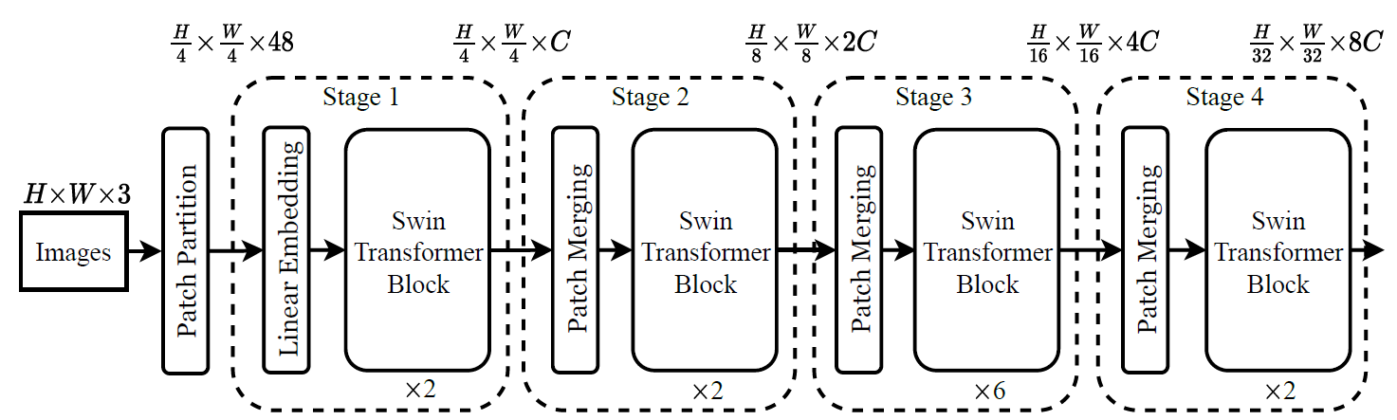
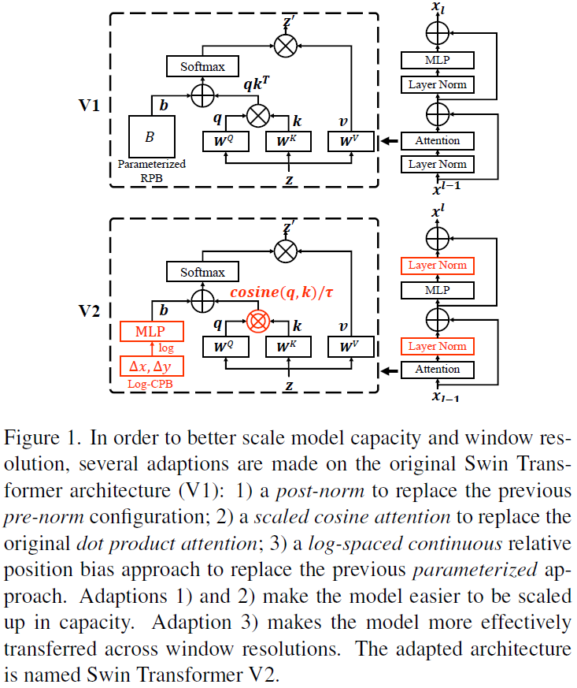
Swin: Brief Review
The architecture of a Swin Transformer V1 (Swin-T)
A Swin Transformer V1 block

Slide 4
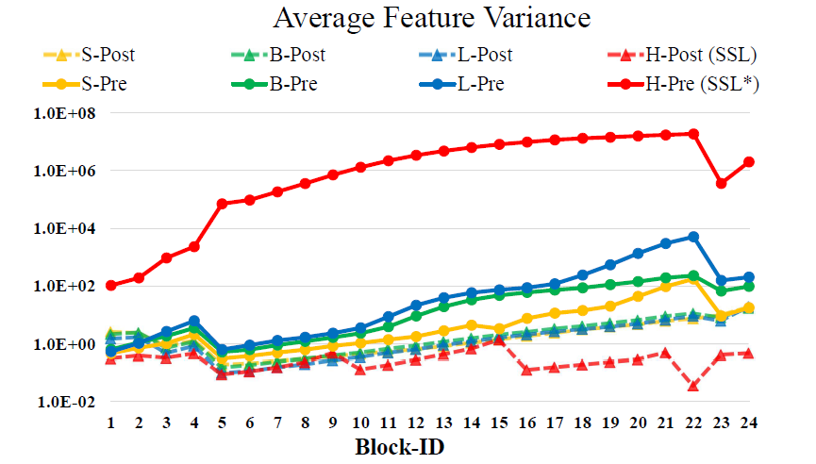
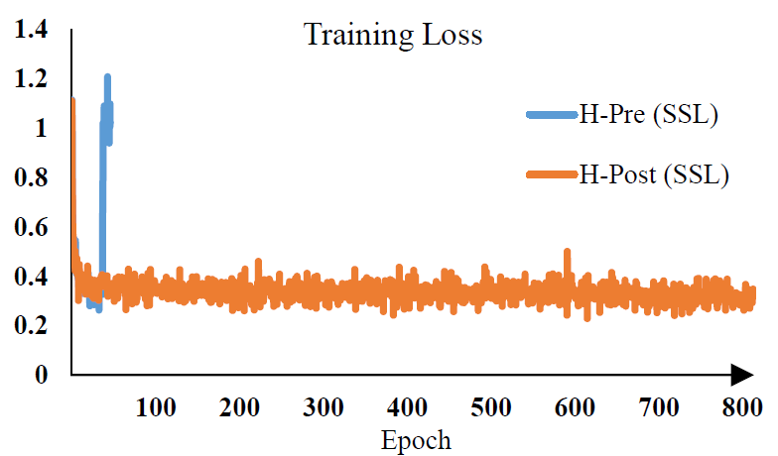
Issues
Training instability when scaling up model capacity
The output activation values of each residual block are directly merged back to the main branch.
As the model is scaled up to larger size, accumulated activation values at deeper layers grow dramatically. At the size of 658 millions parameters, the training cannot be accomplished.
Figure 2. Signal Propagation Plot [5, 62] for various model sizes.
Figure 3. SwinV1-H versus SwinV2-H in training.
A Swin Transformer V1 block

Slide 5
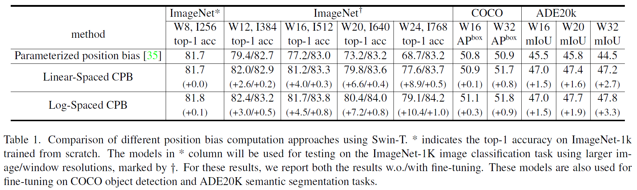
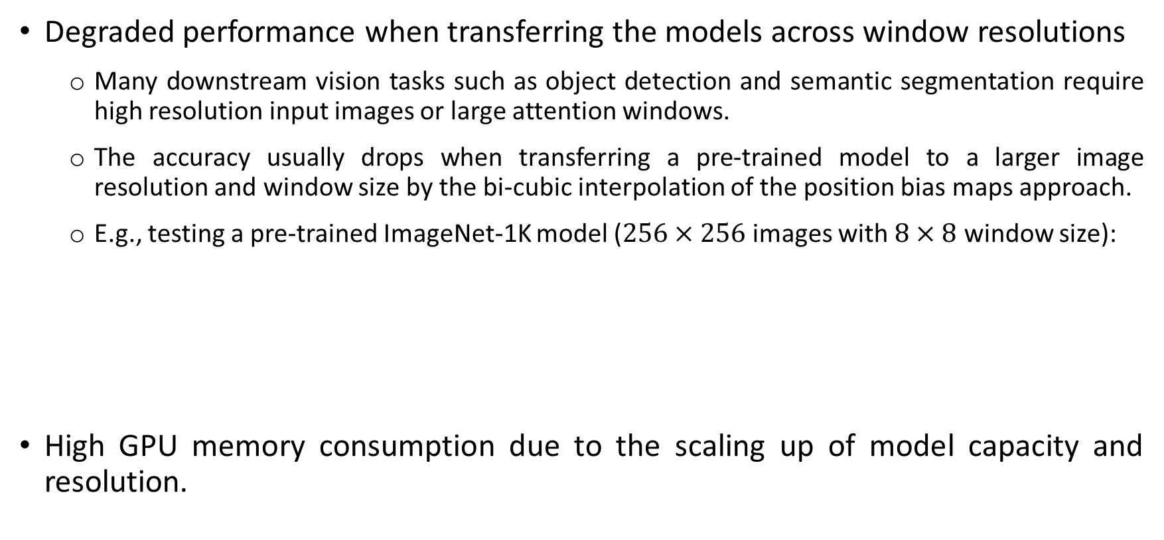
Issues
Degraded performance when transferring the models across window resolutions
Many downstream vision tasks such as object detection and semantic segmentation require high resolution input images or large attention windows.
The accuracy usually drops when transferring a pre-trained model to a larger image resolution and window size by the bi-cubic interpolation of the position bias maps approach.
E.g., testing a pre-trained ImageNet-1K model ($256×256$ images with $8×8$ window size):
High GPU memory consumption due to the scaling up of model capacity and resolution.
81.7
79.4
77.2
73.2
68.7

Slide 6
Swin V2: Overview
Proposed different techniques for:
Scaling up model capacity
Scaling up window resolution
Reducing GPU memory consumption
Training large model with up to 3 billions parameters.

Slide 7
Swin V2: Scaling Up Model Capacity
Post normalization
The output of each residual block is normalized before merged back to the main branch, and the amplitudes of the main branch will not be accumulated when layers go deeper.
In largest model training, additionally a layer normalization unit is introduced on the main branch every 6 Transformer blocks, to further stabilize training and the amplitudes.
Figure 2. Signal Propagation Plot [5, 62] for various model sizes.
Figure 3. SwinV1-H versus SwinV2-H in training.

Slide 8
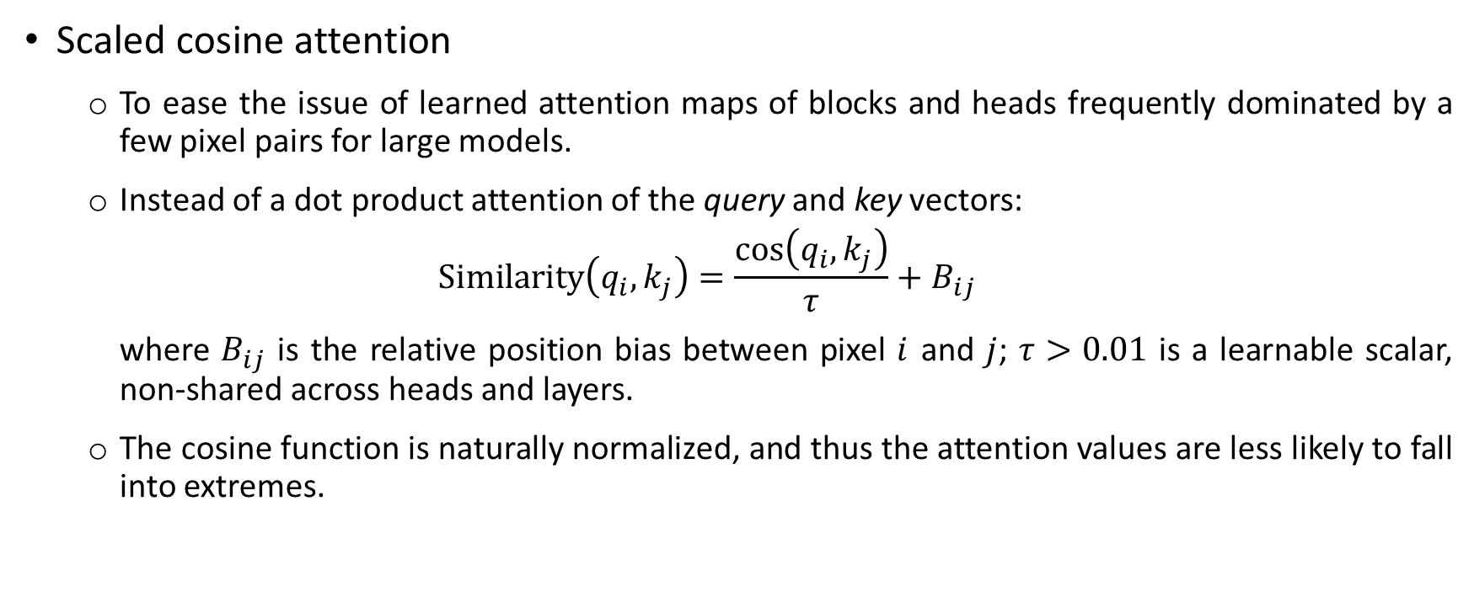
Swin V2: Scaling Up Model Capacity
Scaled cosine attention
To ease the issue of learned attention maps of blocks and heads frequently dominated by a few pixel pairs for large models.
Instead of a dot product attention of the query and key vectors:
$$Similarity\left(q_{i},k_{j}\right)=\frac{\cos\left(q_{i},k_{j}\right)}{τ}+B_{ij}$$
where $B_{ij}$ is the relative position bias between pixel $i$ and $j$; $τ>0.01$ is a learnable scalar, non-shared across heads and layers.
The cosine function is naturally normalized, and thus the attention values are less likely to fall into extremes.

Slide 9
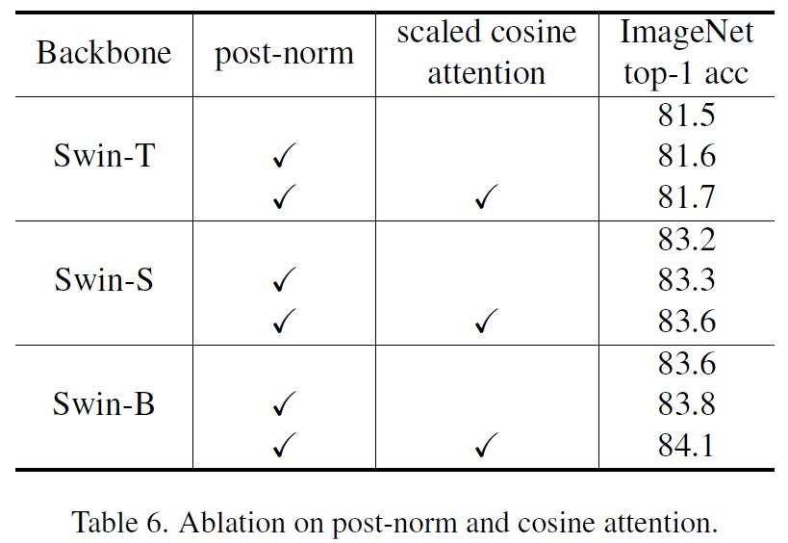
Swin V2: Scaling Up Model Capacity
Ablation on post-norm and scaled cosine attention

Slide 10
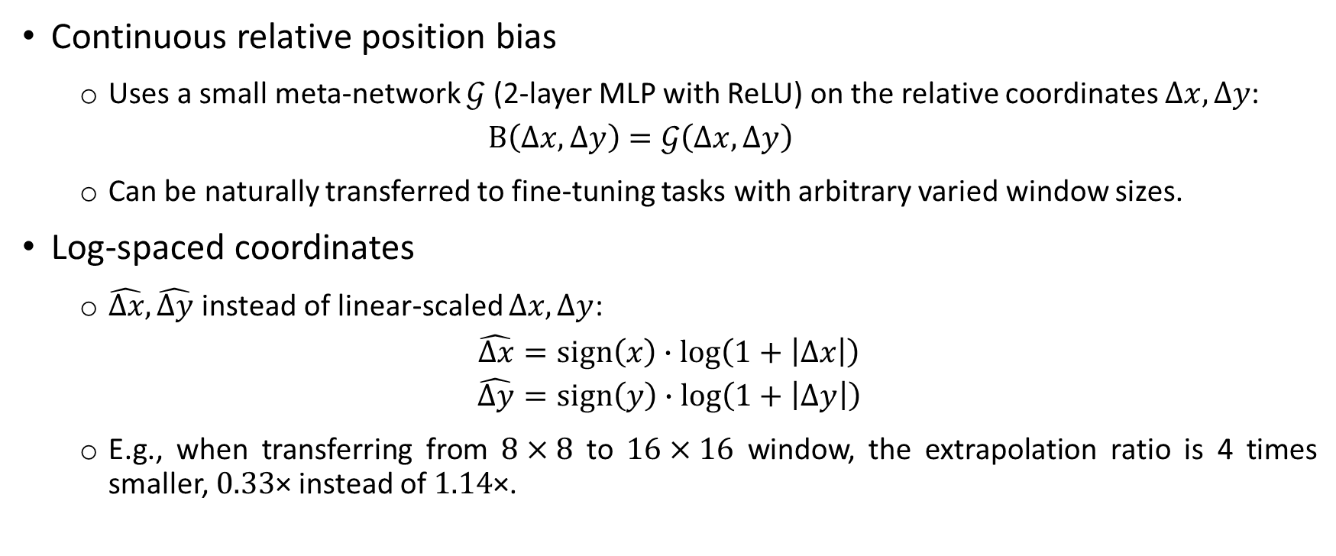
Swin V2: Scaling Up Window Resolution
Continuous relative position bias
Uses a small meta-network $𝒢$ (2-layer MLP with ReLU) on the relative coordinates $Δx,Δy$:
$$B\left(Δx,Δy\right)=𝒢\left(Δx,Δy\right)$$
Can be naturally transferred to fine-tuning tasks with arbitrary varied window sizes.
Log-spaced coordinates
$\hat{Δx},\hat{Δy}$ instead of linear-scaled $Δx,Δy$:
$$\hat{Δx}=sign\left(x\right)∙\log\left(1+\left|Δx\right|\right)$$
$$\hat{Δy}=sign\left(y\right)∙\log\left(1+\left|Δy\right|\right)$$
E.g., when transferring from $8×8$ to $16×16$ window, the extrapolation ratio is 4 times smaller, $0.33$× instead of $1.14$×.

Slide 11
Swin V2: Scaling Up Window Resolution
Ablation on scaling up window resolution by different approaches

Slide 12
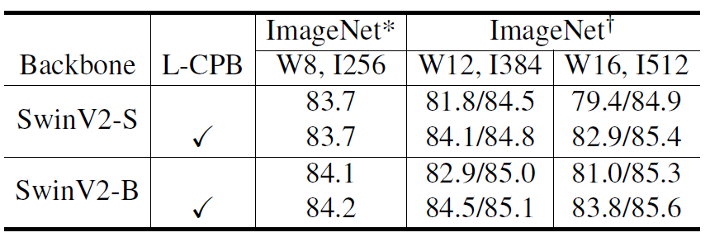
Swin V2: Scaling Up Window Resolution
Ablation on Log-CPB using different model sizes

Slide 13
Swin V2
Figure 1. Architectural adaptations for better scale model capacity and window resolution: 1) a post-norm to replace the previous pre-norm configuration; 2) a scaled cosine attention to replace the original dot product attention; 3) a log-spaced continuous relative position bias approach to replace the previous parameterized approach. Adaptions 1) and 2) make the model easier to be scaled up in capacity. Adaption 3) makes the model more effectively transferred across window resolutions.

Slide 14
Swin V2: Other Implementation
Implementation to save GPU memory
Zero-Redundancy Optimizer (ZeRO)
The model parameters and optimization states are divided and distributed to multiple GPUs, instead of getting broadcasted as a whole to every GPU or a master node.
Significantly reduces memory consumption, has little effect on training speed.
Activation check-pointing
Reduces training speed by almost 30%.
Sequential self-attention computation
Instead of the previous batch computation approach.
Reduces memory consumption, has little effect on training speed.
Notes:
DeepSpeed framework and the ZeRO stage-1 option are used.
Reduce memory consumption from 48GB to below 40GB with 3B model and resolution of 1,536 x 1,536

Slide 15
Swin V2: Other Implementation
Joining with a self-supervised approach
Combines 2 strategies to address data hungry issue on larger model.
Leveraging huge labelled data: enlarge ImageNet-22K by 5 times to reach 70m images with noisy labels.
Employing a self-supervised learning approach to better exploit this data.

Slide 16
Swin V2: Model Configurations
Similar to Swin V1:
SwinV2-T: C = 96, layer numbers = {2; 2; 6; 2}
SwinV2-S: C = 96, layer numbers = {2; 2; 18; 2}
SwinV2-B: C = 128, layer numbers = {2; 2; 18; 2}
SwinV2-L: C = 192, layer numbers = {2; 2; 18; 2}
Further scaled up models with 658 millions and 3 billions parameters:
SwinV2-H: C = 352, layer numbers = {2; 2; 18; 2}
SwinV2-G: C = 512, layer numbers = {2; 2; 42; 2}

Slide 17
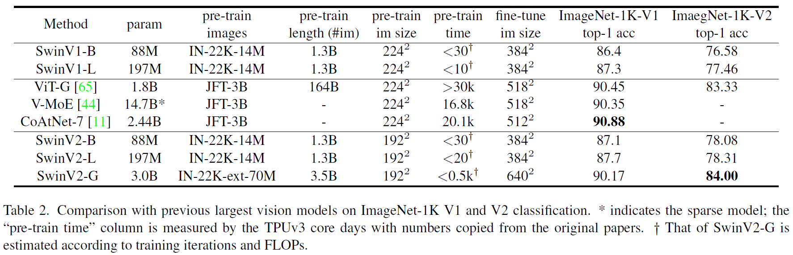
Experiment Results on ImageNet-1K
Notes:
ImageNet V1: 1000 object classes,1,281,167 training images, 50,000 validation images and 100,000 test images
ImageNet V2: 3 test sets with 10,000 new images each. Importantly, these test sets were sampled after a decade of progress on the original ImageNet dataset.
SwinV2-G’s lower accuracy on ImageNet-1K V1 might come from different degrees of dataset over-tuning, and much less training iterations and lower image resolution than previous works.
The shrinked gain by SwinV2-L than that of SwinV2-B may imply more labelled data, stronger regularization, or advanced self-supervised learning approaches are required if beyond this size.

Slide 18
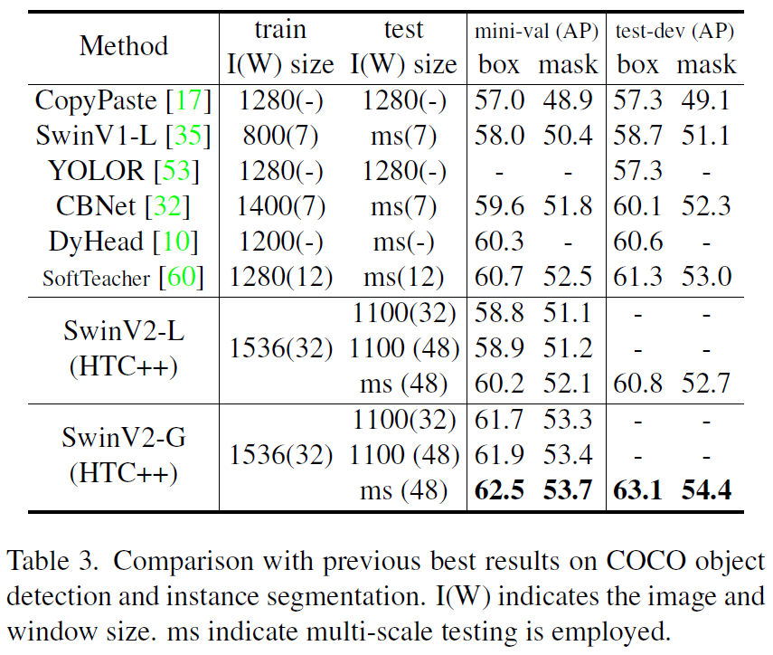
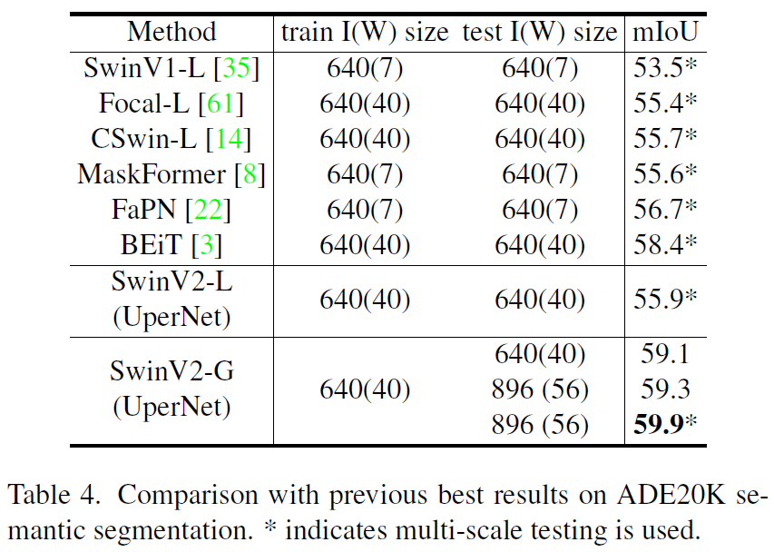
Experiment Results on COCO & ADE20K

Slide 19
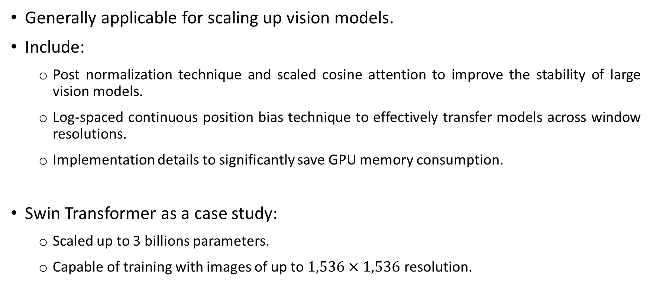
Conclusion: Techniques for Model Upscale
Generally applicable for scaling up vision models.
Include:
Post normalization technique and scaled cosine attention to improve the stability of large vision models.
Log-spaced continuous position bias technique to effectively transfer models across window resolutions.
Implementation details to significantly save GPU memory consumption.
Swin Transformer as a case study:
Scaled up to 3 billions parameters.
Capable of training with images of up to $1,536×1,536$ resolution.

Slide 20
Thank you for listening

